Slide 1
RANSAC
Random Sample Consensus
2021.10.27
Dong Lu

Slide 2
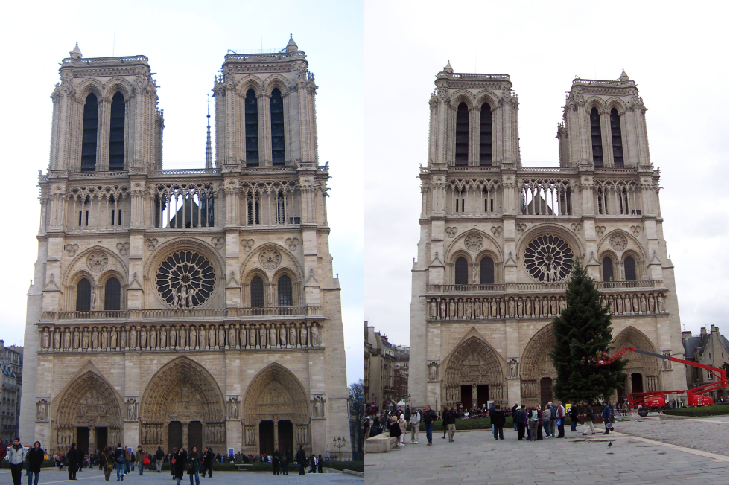
Example:

Slide 3

SIFT All Matches:

Slide 4
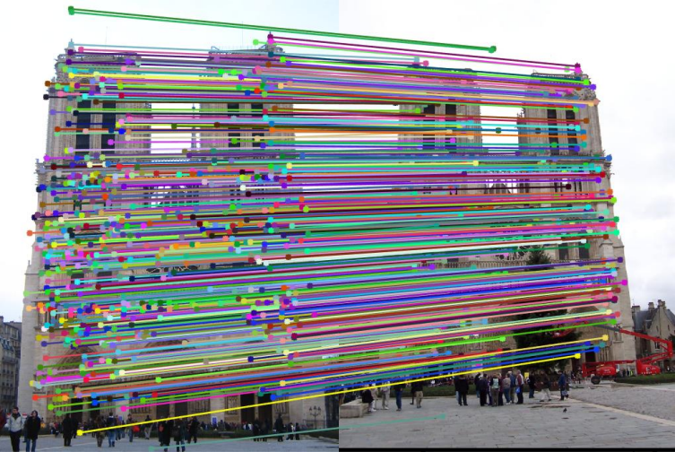
SIFT Inliers:

Slide 5
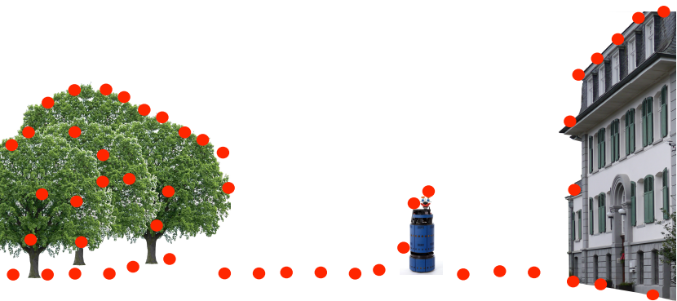
Fitting Example: Ground Plane

Slide 6
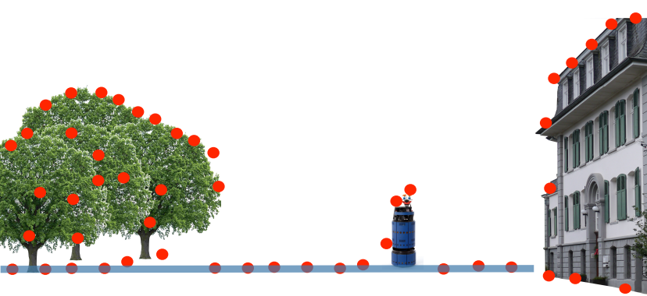
Fitting Example: Ground Plane

Slide 7
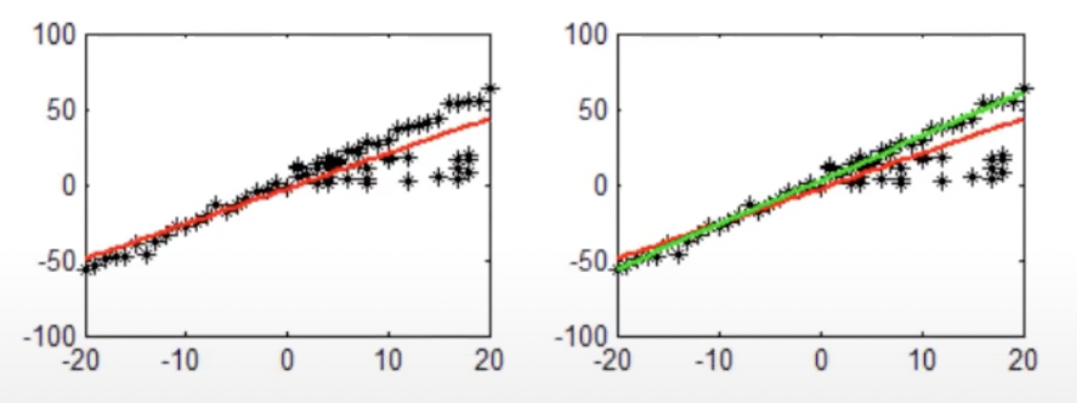
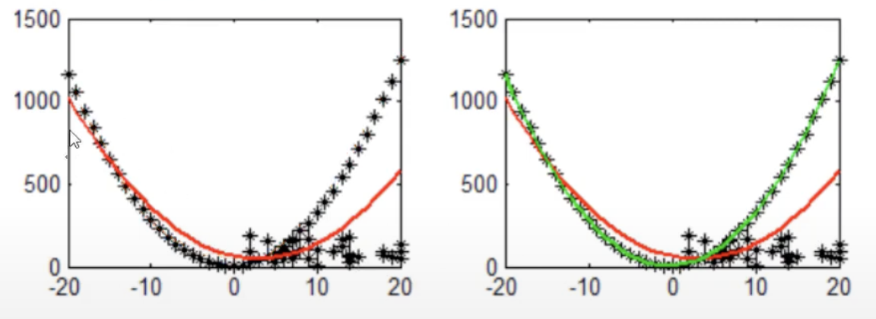
LLS vs RANSAC:
LLS
RANSAC

Slide 8
RANSAC
Random Sample Consensus

Slide 9
RANdom Sample Consensus:
Trial-and-error approach
Approach to deal with high fractions of outliers in the data
Key idea: Find the best partition of points in inlier set and outlier and estimate the model from the inlier set
Standard approach for fitting in the presence of outliers

Slide 10
Algorithm:
Sample the number of data points required to fit the model
Compute model parameters using the sampled data points
Score by the fraction of inliers within a preset threshold of the model
Repeat 1-3 K times, then choose the best model with largest number of inliers

Slide 11

Example of RANSAC:

Slide 12
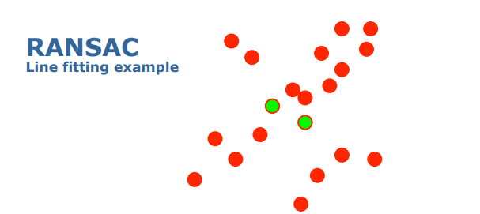
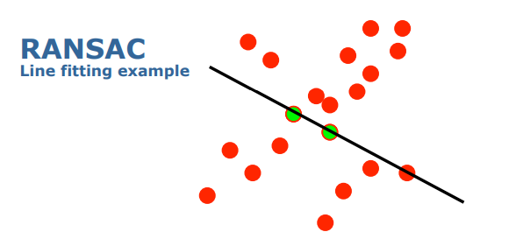
Example of RANSAC:

Slide 13
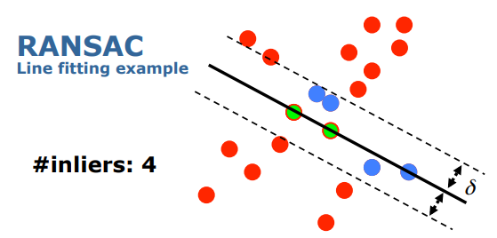
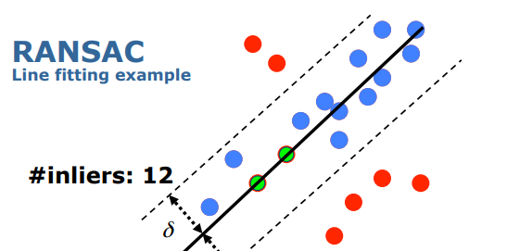
Example of RANSAC:

Slide 14
How to choose the parameters?
Number of sampled points s
(minimum number needed to fit the model)
Outlier ratio e (e=#outliers/#datapoints)
How many trails do we need?

Slide 15
How to choose the parameters?
Number of sampled points s
(minimum number needed to fit the model)
Outlier ratio e (e=#outliers/#datapoints)
Number of trials K
Choose K so that, with probability p, at least one random sample set is free from outliers

Slide 16
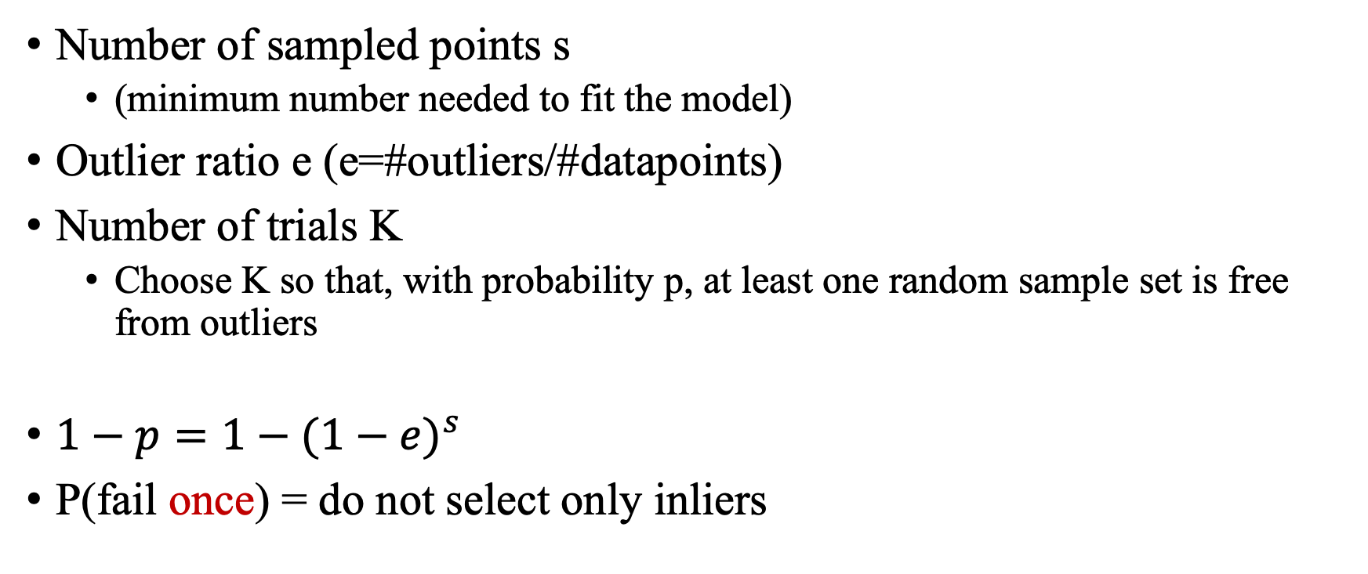
How to choose the parameters?
Number of sampled points s
(minimum number needed to fit the model)
Outlier ratio e (e=#outliers/#datapoints)
Number of trials K
Choose K so that, with probability p, at least one random sample set is free from outliers
$1−p=1−{(1−e)}^{s}$
P(fail once) = do not select only inliers

Slide 17
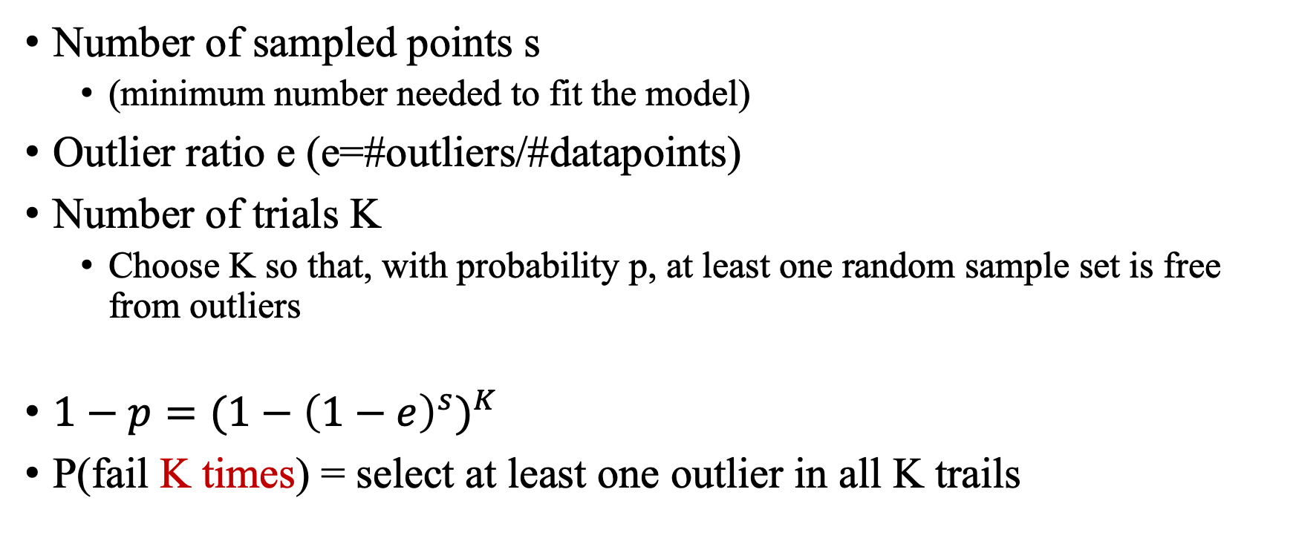
How to choose the parameters?
Number of sampled points s
(minimum number needed to fit the model)
Outlier ratio e (e=#outliers/#datapoints)
Number of trials K
Choose K so that, with probability p, at least one random sample set is free from outliers
$1−p={(1−{\left(1−e\right)}^{s})}^{K}$
P(fail K times) = select at least one outlier in all K trails

Slide 18
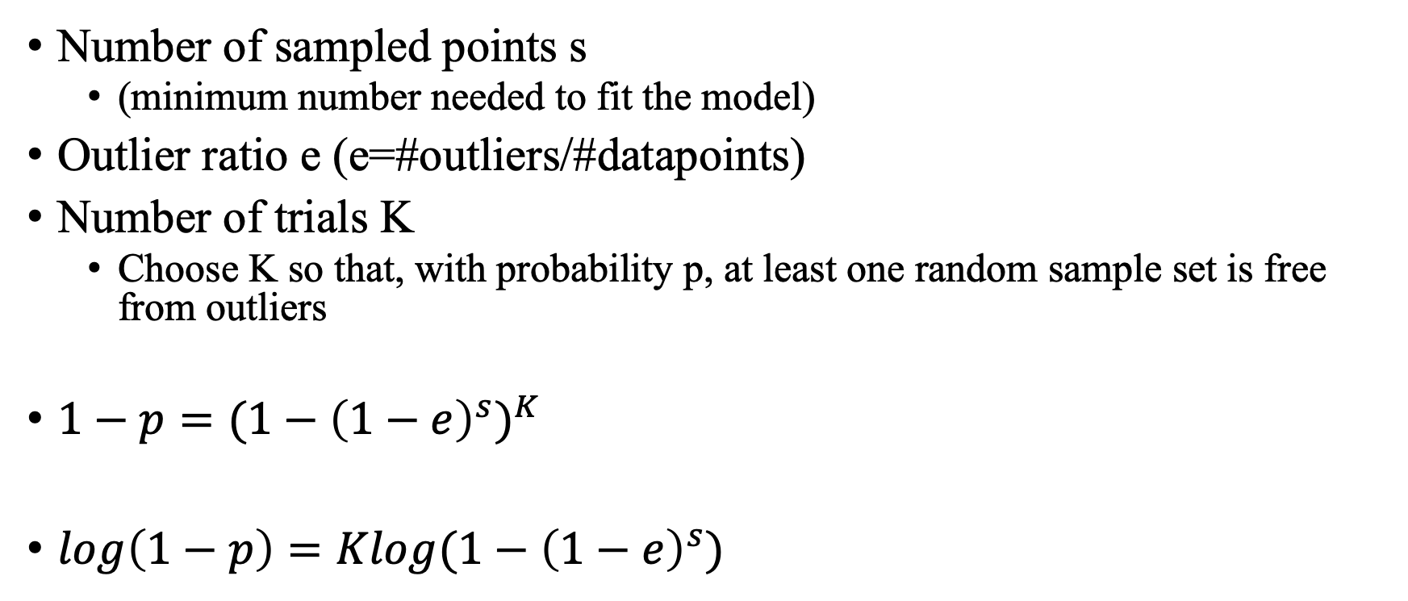
How to choose the parameters?
Number of sampled points s
(minimum number needed to fit the model)
Outlier ratio e (e=#outliers/#datapoints)
Number of trials K
Choose K so that, with probability p, at least one random sample set is free from outliers
$1−p={(1−{\left(1−e\right)}^{s})}^{K}$
$\log\left(1−p\right)=Klog(1−{\left(1−e\right)}^{s})$

Slide 19
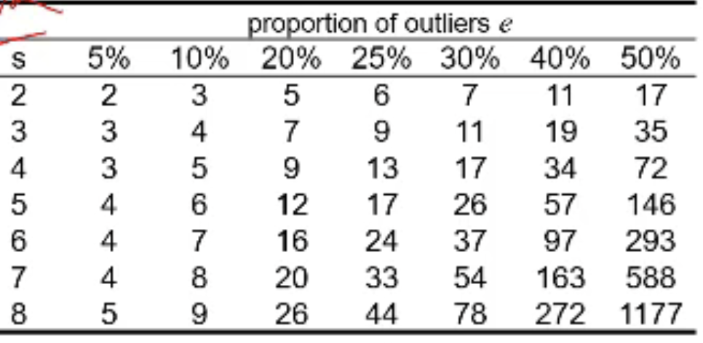
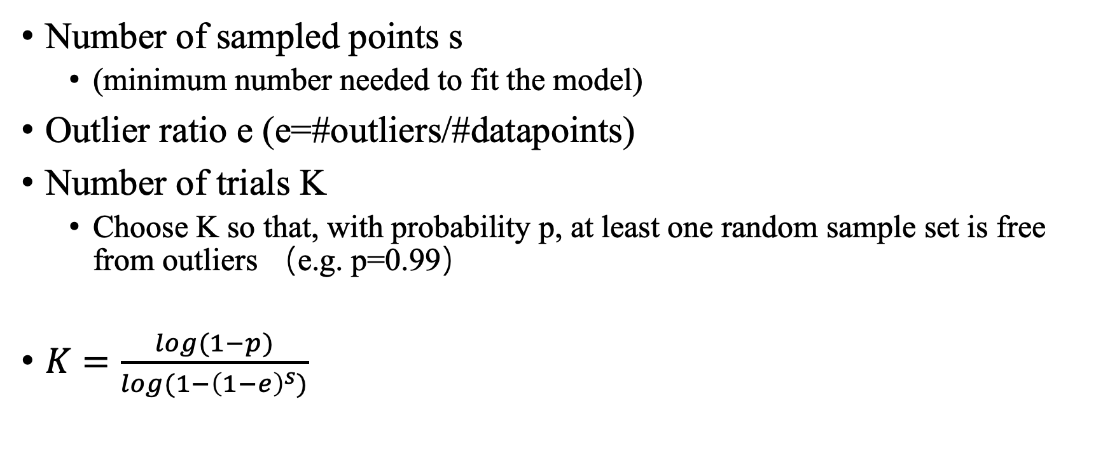
How to choose the parameters?
Number of sampled points s
(minimum number needed to fit the model)
Outlier ratio e (e=#outliers/#datapoints)
Number of trials K
Choose K so that, with probability p, at least one random sample set is free from outliers （e.g. p=0.99）
$K=\frac{log(1−p)}{log(1−{\left(1−e\right)}^{s})}$

Slide 20
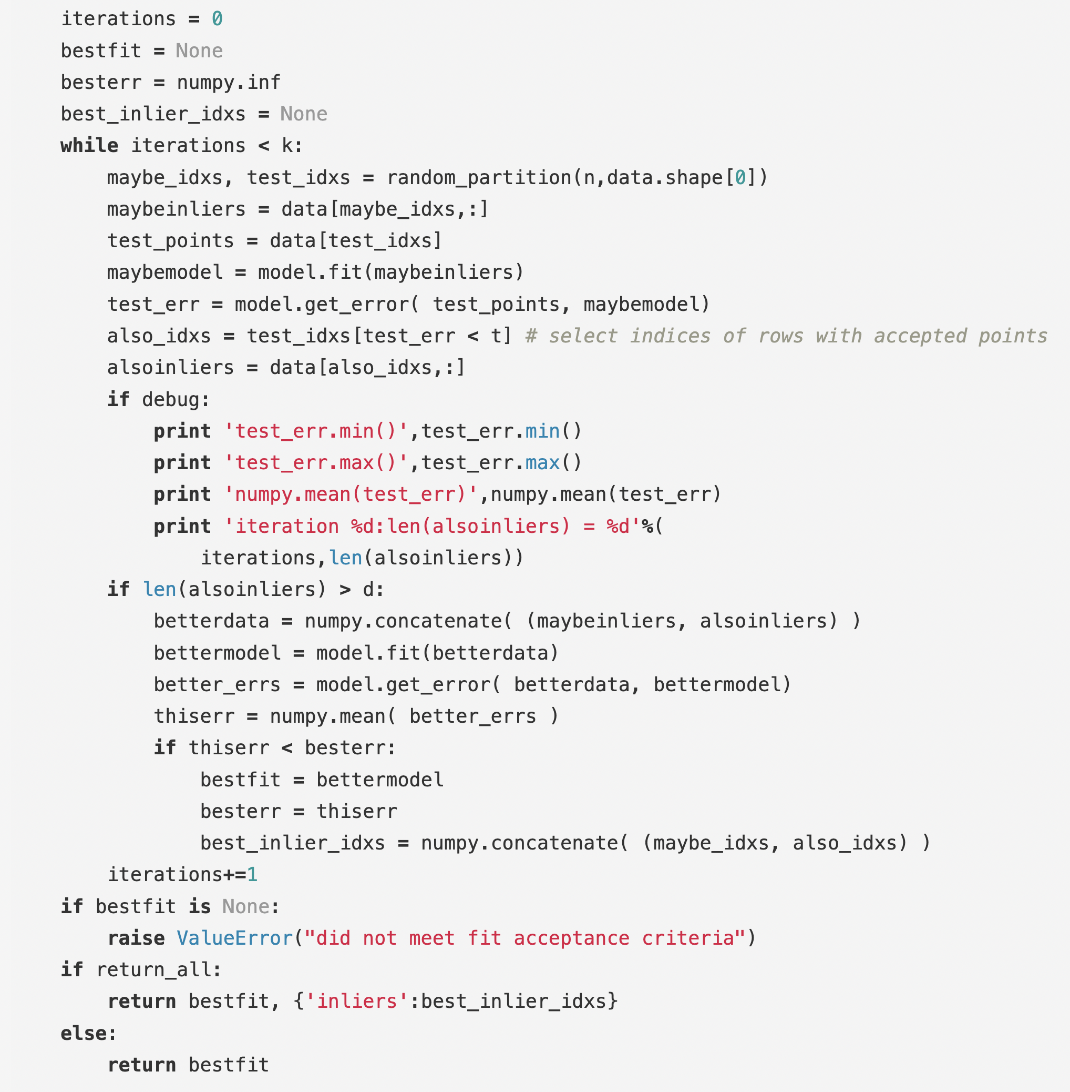
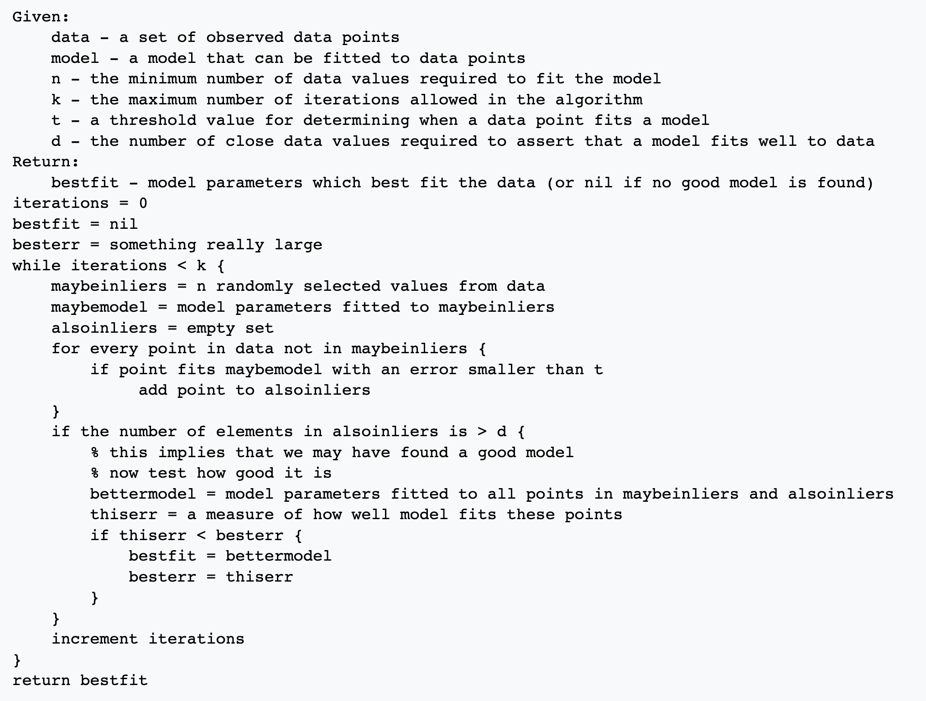
Code:

